Slide 1
Installing Anaconda & Starting Jupyter Notebook and Spyder
Felix Riedel

Slide 2
Installing Anaconda
Anaconda is one of the most popular Data Science Platforms and provides multiple different integrated development environments (IDE).
In this course we will primarily use Jupyter Notebook as an IDE, but you are free to use Sypder, PyCharm or any other Python DIE of your choosing.
Anaconda can be downloaded via the following link. Just choose the version for your distribution.
https://www.anaconda.com/distribution/
To start either jupyter notebook or spyder, open the anaconda prompt by typing in „anaconda prompt“ into the windows search bar and type in either „jupyter notebook“ or „spyder“
Alternatively you can directly search for either term in the windows search bar. But since we will change some settings later on, the first way is recommended.
The Jupyter Notebook UI is explained in the script, therefore only the Spyder UI is explained on the following slides.

Slide 3
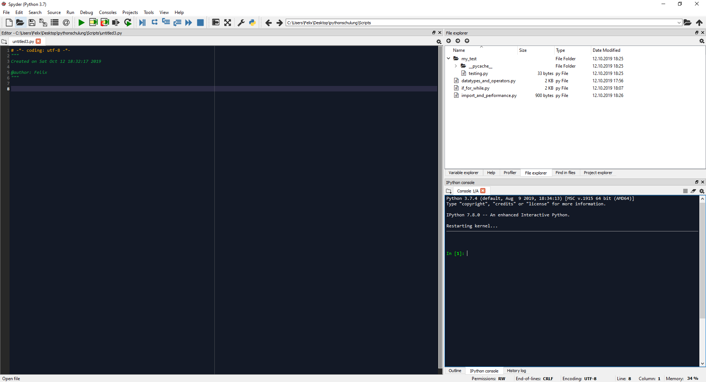
Spyder UI
Next page
Navigate to folder with scripts
->
Set Console Working Directory

Slide 4
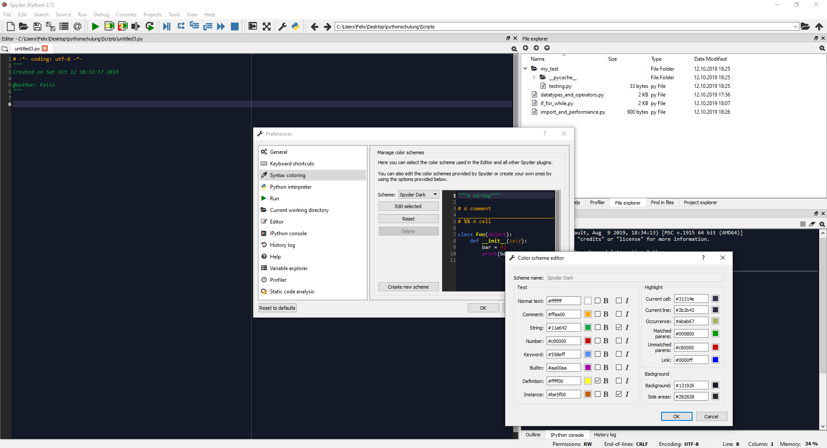
Change Syntax Coloring

